Slide 1
🏍️
Rally Bonus Planner
From creating your account to exporting a GPX file — a rider's guide to every feature
Prepared for new riders · rally-planner · gregrice.com

Slide 2
1
Getting Started
Create your account, set up your rider profile and motorcycle, and learn how the app is organized.
Rally Bonus Planner — Rider Guide
1 / 52

Slide 3
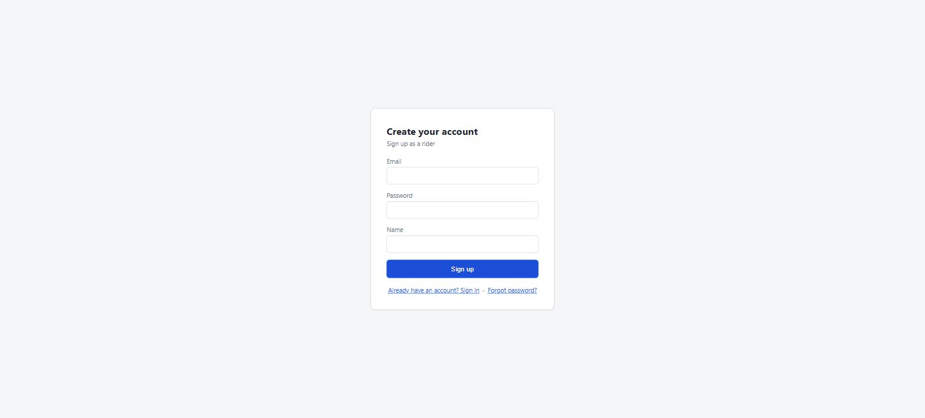
👤
GETTING STARTED
Creating an account
From the sign-in screen, click Need an account? Sign up
Enter your email, a password, and your display name, then click Sign up
You're signed in immediately and dropped into the app with an empty rally list
New accounts start as a regular rider — an existing admin can promote you later if you need admin access
The sign-up form — email, password, and display name are all that's required.
Rally Bonus Planner — Rider Guide
2 / 52

Slide 4
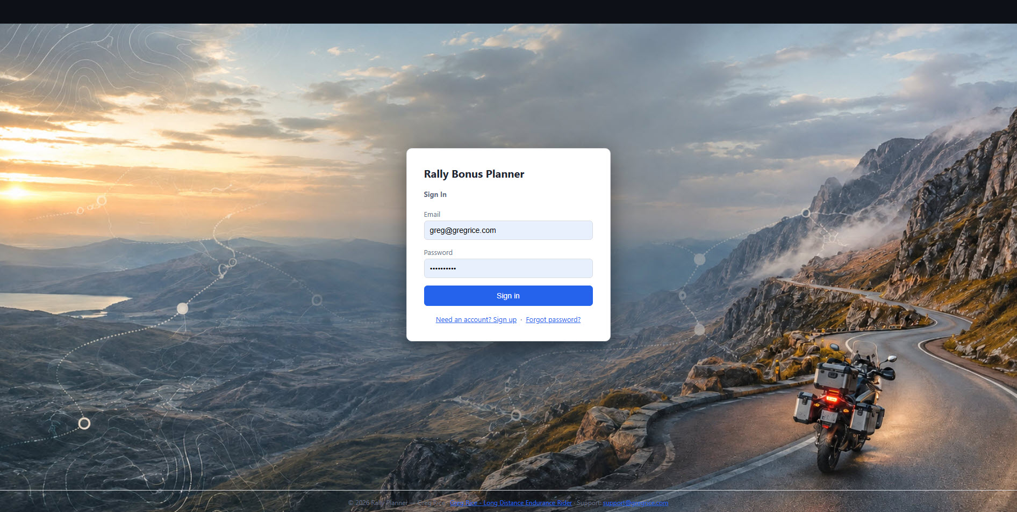
🔑
GETTING STARTED
Signing in
Enter your email and password on the sign-in screen and click Sign in
Forgot your password? Use the Forgot password? link to request a reset email
Sessions stay active across browser restarts — you generally only sign in once per device
Every sign-in shows a Welcome popup with a standing reminder about imported data
The sign-in screen.
Rally Bonus Planner — Rider Guide
3 / 52

Slide 5
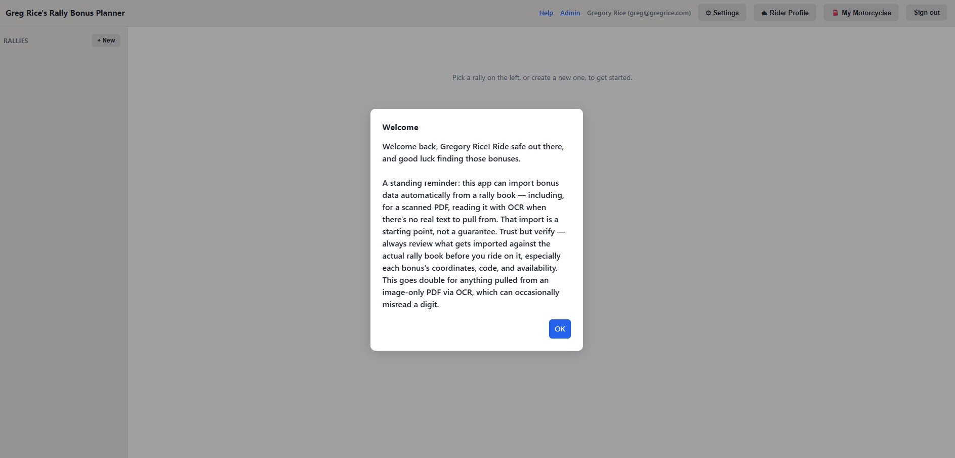
⚠️
GETTING STARTED
Trust, but verify
Every sign-in greets you by name with a standing reminder, not a one-time notice
Anything the app imports automatically — especially OCR'd data from a scanned rally-book PDF — is a starting point, not a guarantee
Always double-check an imported bonus's coordinates, code, and availability against the actual rally book before you ride on it
Click OK to dismiss it and get to your rally list
The Welcome popup — a "trust but verify" reminder every sign-in.
Rally Bonus Planner — Rider Guide
4 / 52

Slide 6
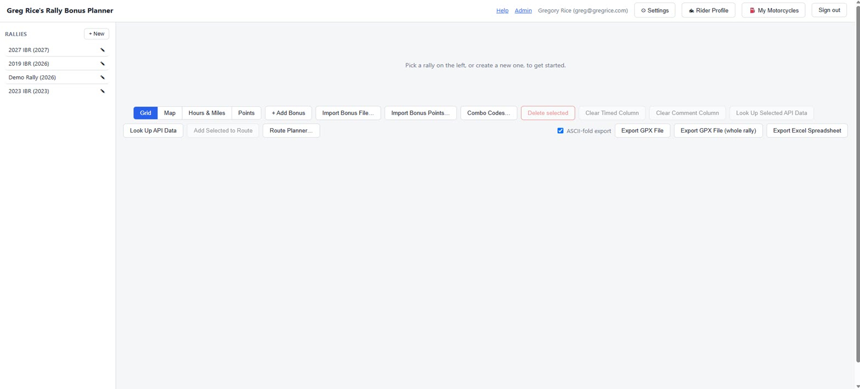
🗂️
GETTING STARTED
How the app is organized
Rallies — the top-level events you're planning for, e.g. "2027 Iron Butt Rally." Click + New to add one.
Legs — appear once you select a rally. Each leg is a segment with its own start/end time, used to calculate sunrise/sunset.
Bonuses — appear once you select a leg, in the grid on the right. This is where you'll spend most of your time.
Selecting a rally reveals its legs; selecting a leg loads its bonuses into the grid.
Rally Bonus Planner — Rider Guide
5 / 52

Slide 7
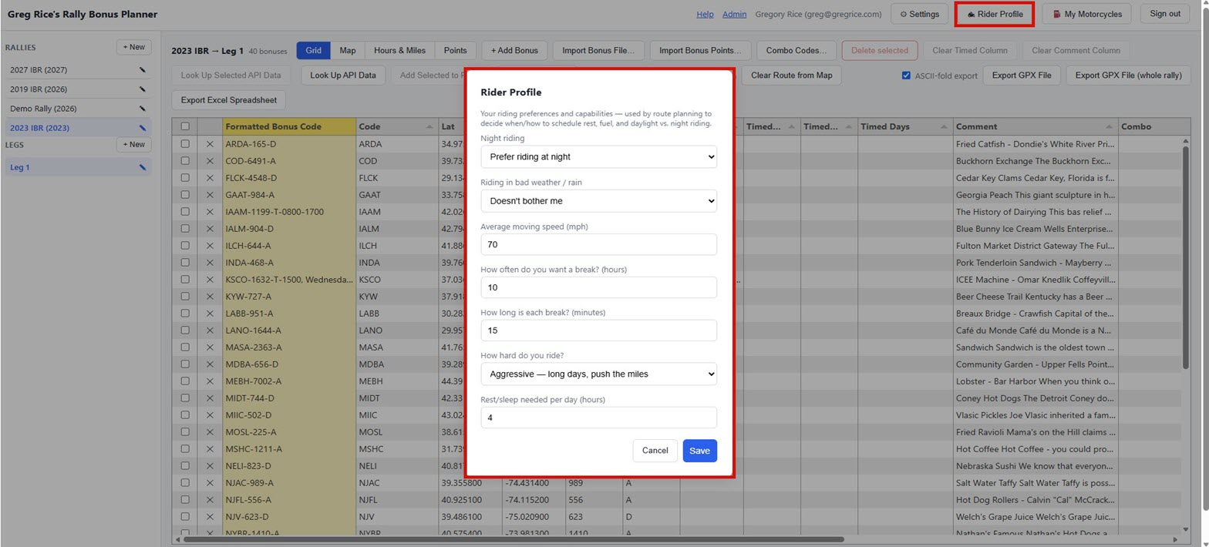
🏍️
GETTING STARTED
Rider profile
Click 🏍 Rider Profile in the header to record how you like to ride
Night-riding and bad-weather tolerance, average moving speed, rest-stop habits, daily mileage intensity, and sleep needs
Saved once to your account — not per rally — and feeds Build Route Schedule and 🎯 AI Suggested Route
Completely optional: leave the defaults if you'd rather not fill it in
The Rider Profile dialog, opened from the header.
Rally Bonus Planner — Rider Guide
6 / 52

Slide 8
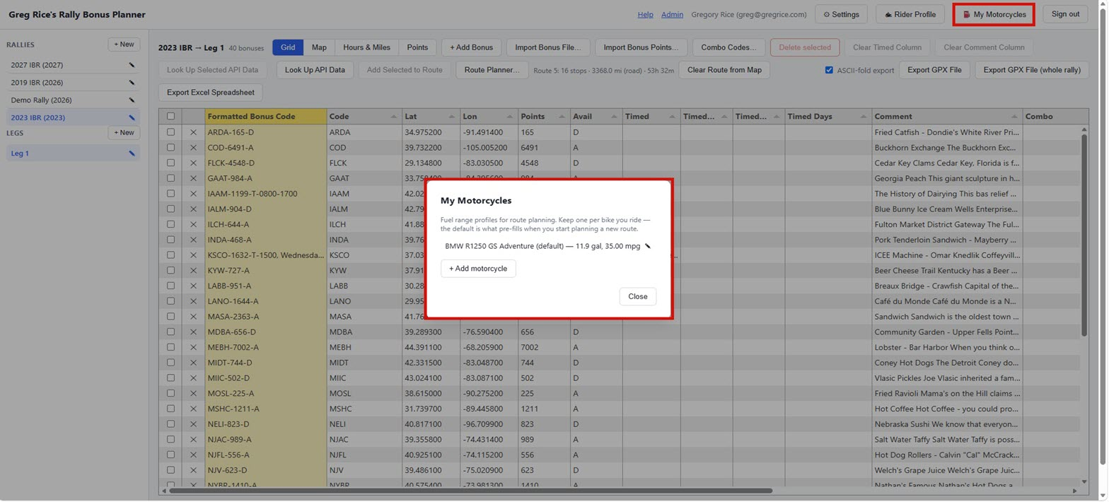
⛽
GETTING STARTED
My motorcycles
Click ⛽ My Motorcycles in the header to keep one or more fuel-range profiles
Main + auxiliary tank capacity, average fuel consumption, reserve, and a safety-buffer percentage
Mark one Default motorcycle and it pre-fills automatically when you start planning a new route
Every field follows your Units setting — imperial shows gallons/MPG, metric shows liters/L per 100 km
One row per bike, with its usable range and MPG at a glance.
Rally Bonus Planner — Rider Guide
7 / 52

Slide 9
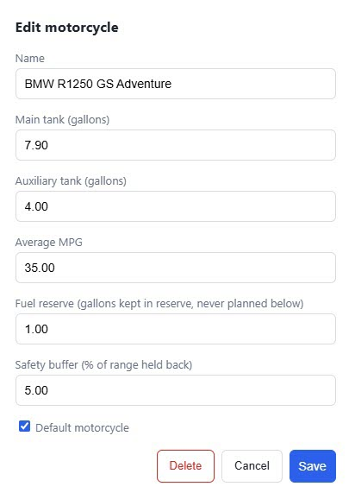
⛽
GETTING STARTED
Motorcycles feed your fuel range
Click a motorcycle to edit it, or + Add motorcycle for another
Picking a bike for a route fills in Fuel range automatically: usable tank capacity × MPG, minus your safety buffer
You can still type over that number yourself any time
Optional, like the rider profile — the route planner's Fuel range field works fine without picking a bike here
Editing a motorcycle profile — Default marks the one that pre-fills new routes.
Rally Bonus Planner — Rider Guide
8 / 52

Slide 10
2
Rallies, Legs & Bonuses
Build the rally → leg → bonus structure, then import or enter the bonuses you'll ride.
Rally Bonus Planner — Rider Guide
9 / 52

Slide 11
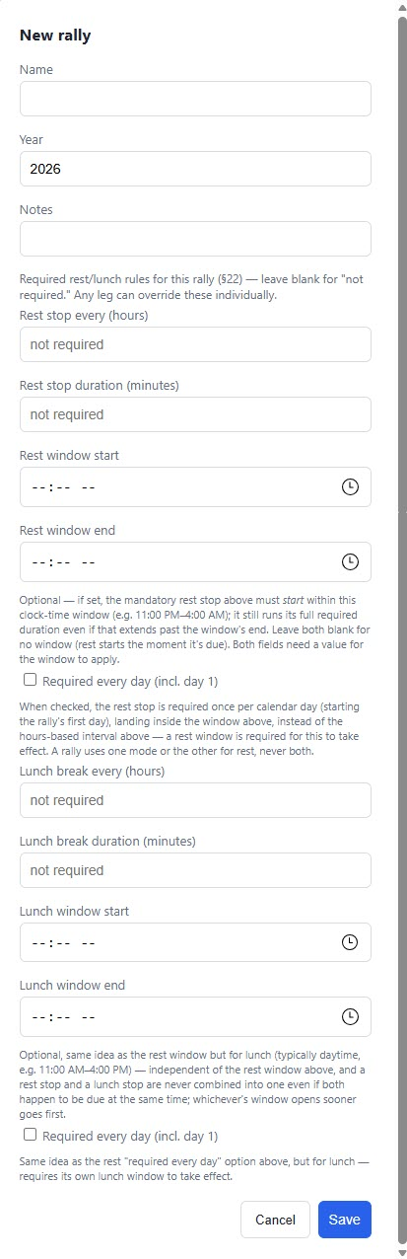
🏁
RALLIES & LEGS
Creating a rally
Click + New above the rally list
Give it a name and, optionally, a year and notes, then Save
Year defaults to the current year but can be changed
To edit or delete later, click the ✎ next to its name — deleting a rally also deletes all its legs and bonuses (confirmation required)
The New rally dialog.
Rally Bonus Planner — Rider Guide
10 / 52

Slide 12
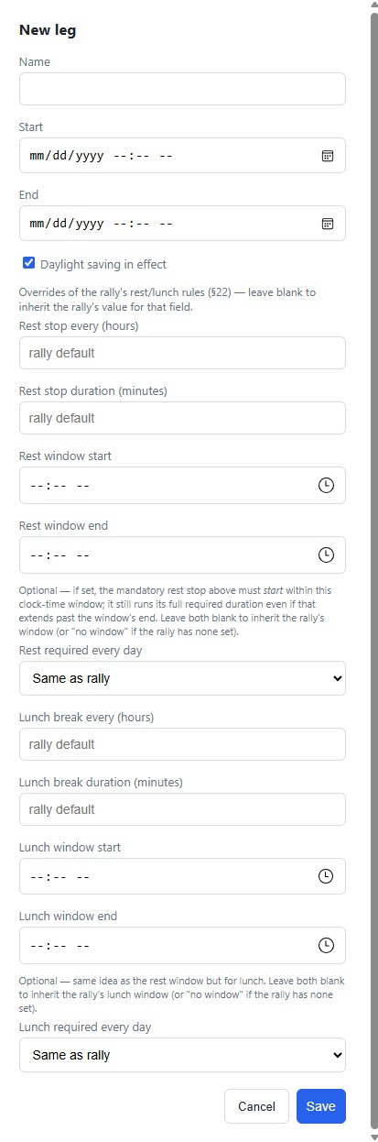
🧭
RALLIES & LEGS
Creating a leg
With a rally selected, click + New above the leg list
Give it a name and a start/end date-time — this unlocks sunrise/sunset lookups for every bonus on that leg
Start location and End location fields save the hotel a leg begins/ends at — type an address and click Look up
A leg's saved end location auto-fills the next leg's start location, so you're not retyping the same hotel
The New leg dialog — Start/End are optional but unlock sunrise/sunset lookups.
Rally Bonus Planner — Rider Guide
11 / 52

Slide 13
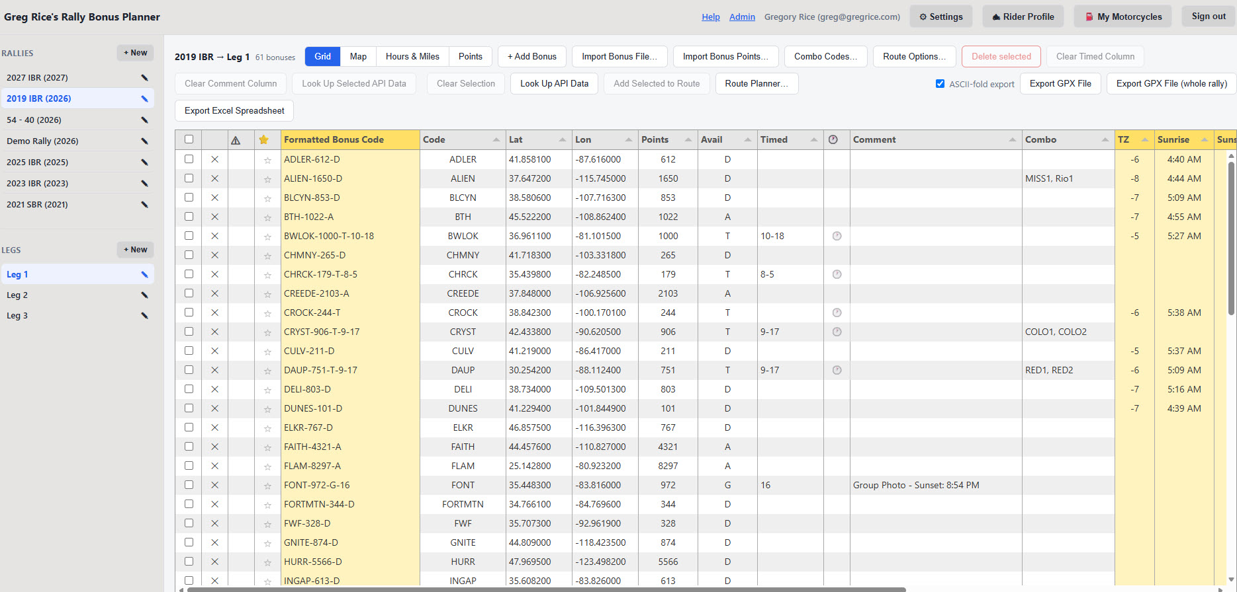
📋
RALLIES & LEGS
The bonus grid
Selecting a leg loads its bonuses into a spreadsheet-style grid — click any cell to edit it in place
Changes save automatically — watch the small save indicator next to your name in the header
Columns reorder, sort, and resize; scroll right for Sunrise, Sunset, Address, and Symbol
Formatted Bonus Code updates automatically as you edit — the CODE-POINTS-AVAIL-TIMED name used in GPX exports
A leg's bonus grid — column headers all have explanatory tooltips.
Rally Bonus Planner — Rider Guide
12 / 52

Slide 14
⭐
RALLIES & LEGS
Marking a bonus mandatory
The ⭐ column marks a bonus you already know you have to ride — one the rally book itself calls mandatory
This is entirely your own call — the app never sets it automatically, even on import
Its whole effect is inside 🎯 AI Suggested Route: a starred bonus becomes a hard requirement instead of an optional candidate
Building a route by hand, Optimize Route, and exports all ignore the star completely
The ⭐ star column sits right next to the ⚠ flag column in the bonus grid — click it to mark a bonus mandatory.
Rally Bonus Planner — Rider Guide
13 / 52

Slide 15
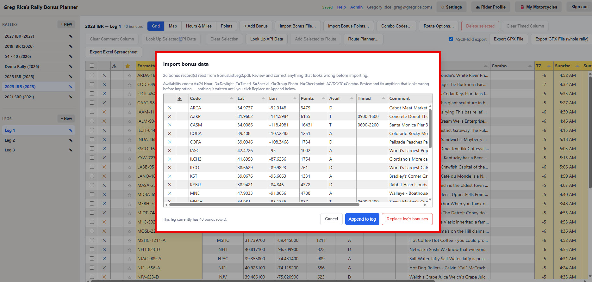
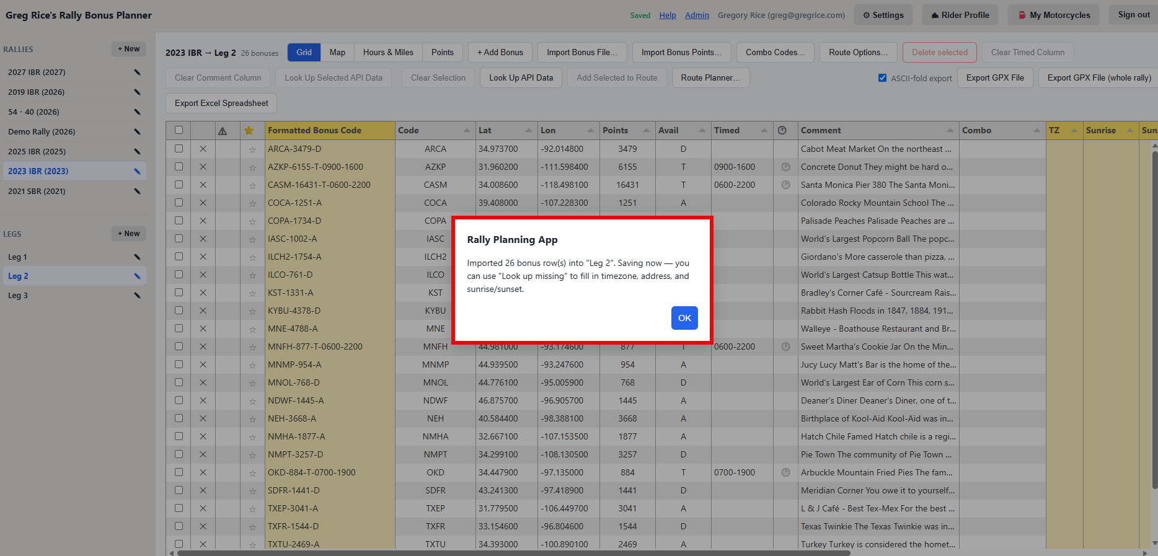
📥
RALLIES & LEGS
Importing bonus files
Click Import file… and choose .gpx, .kml, .csv, .tsv, .txt, Excel, or .pdf
Parsed entirely in your browser with a preview grid — nothing is written until you click Append or Replace
PDF import is built for Iron Butt-style bonus packets: code, points, coordinates, hours, description
Monitoring bonuses and checkpoint info have no coordinates, so they're skipped automatically
Import preview for a 162-bonus GPX file.
Confirms how many rows were imported and reminds you to run Look up missing next.
Rally Bonus Planner — Rider Guide
14 / 52

Slide 16
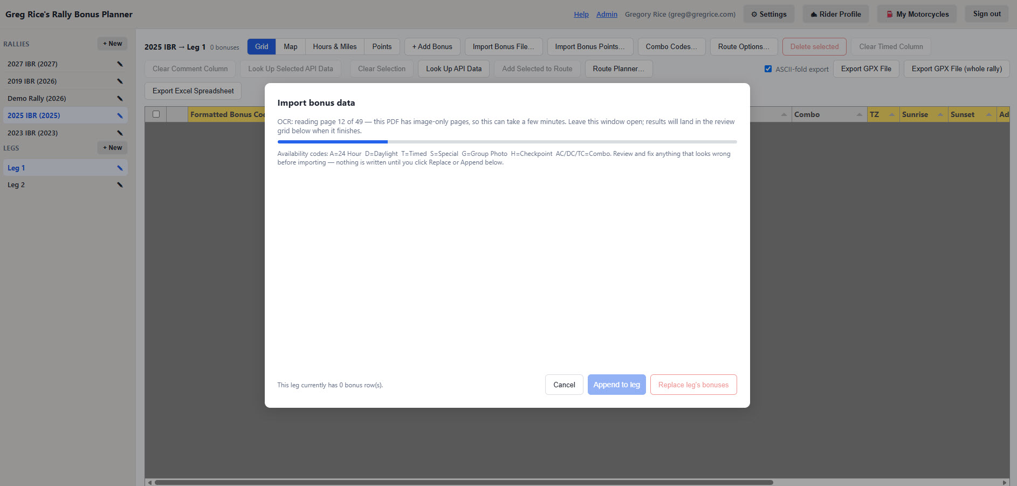
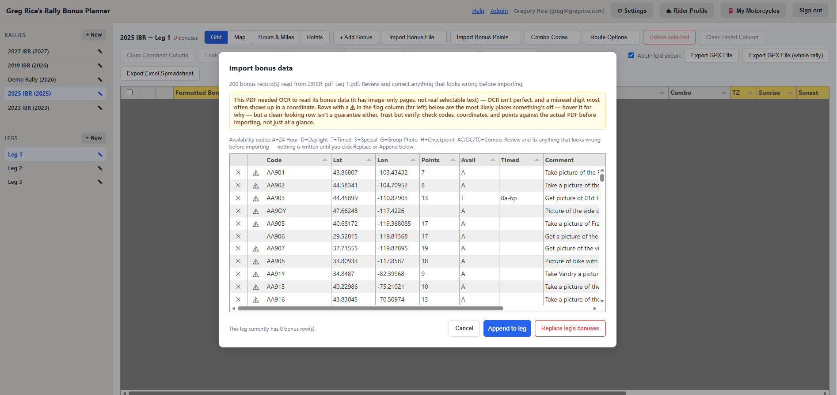
🔎
RALLIES & LEGS
Scanned rally books: automatic OCR
Some rally books' bonus pages are flattened images, not real selectable text
If a PDF comes back "No bonus records were found," the app automatically retries with OCR
This can take several minutes on a large book — a page counter shows it isn't stalled
OCR is less reliable: a row it isn't confident about gets a ⚠ flag with a specific reason — check the preview closely
OCR reading a scanned rally book, page by page.
The review grid after an OCR'd import — the ⚠ flag column points at rows worth a closer look.
Rally Bonus Planner — Rider Guide
15 / 52

Slide 17
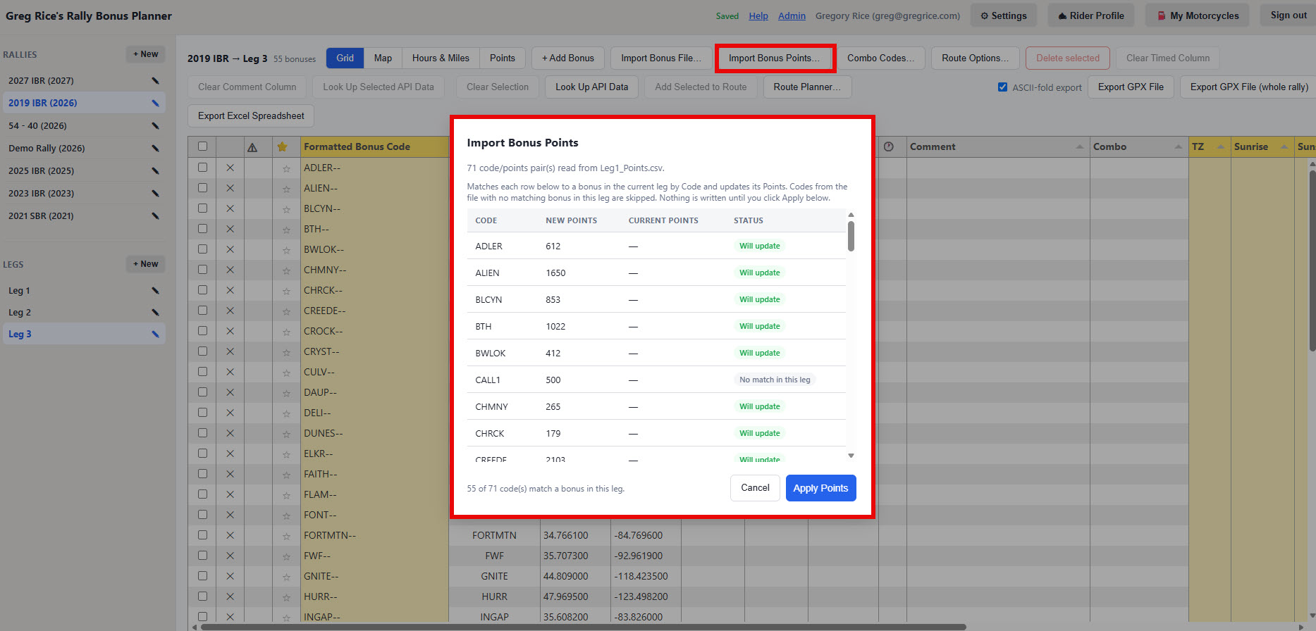
🧮
RALLIES & LEGS
Importing a points file
Some rally masters publish locations and point values as two separate files
Click Import points… and choose the codes/points file to merge it into the current leg
Unlike Import file…, this never adds or removes rows — it only matches codes and updates Points
A preview shows every code, whether it matched, and its current vs. new value before anything applies
Code, New points, Current points, and a Status column flagging unmatched codes.
Rally Bonus Planner — Rider Guide
16 / 52

Slide 18
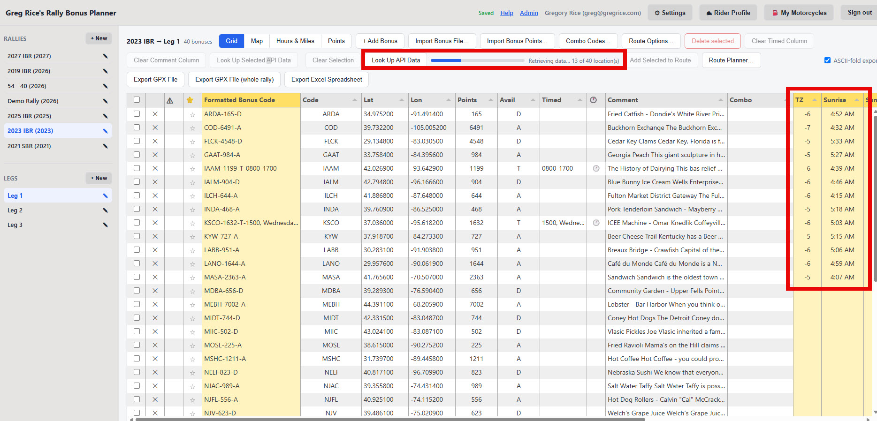
📍
RALLIES & LEGS
Looking up address & timezone
Once a bonus has coordinates, click Look up missing to fill in timezone, reverse-geocoded address, and sunrise/sunset
Runs in the background with a progress indicator, for every bonus that's missing this data
Results are cached — re-running it doesn't re-charge lookups for bonuses already looked up
Lookups are rate-limited per account; if you hit the limit, wait a bit and try again
A lookup running in the background — the progress bar shows what's left to process.
Rally Bonus Planner — Rider Guide
17 / 52

Slide 19
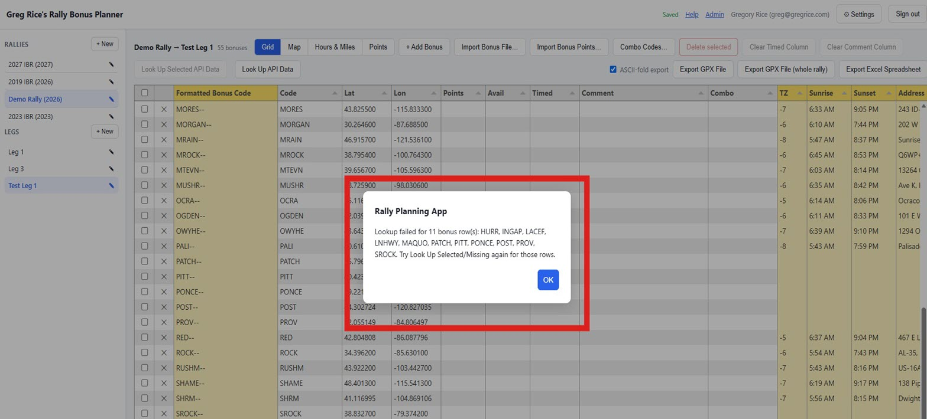
📍
RALLIES & LEGS
When a lookup batch hits a rate limit
A large batch can occasionally run into the timezone API's own rate limit
When it does, a popup lists exactly which bonus codes were missed — nothing else is affected
Run Look Up Selected/Missing again to fill in just those rows
Sunrise/sunset only resolve once the leg's own start/end date-time is set
Exactly which bonus codes were missed, so you can re-run just those.
Rally Bonus Planner — Rider Guide
18 / 52

Slide 20
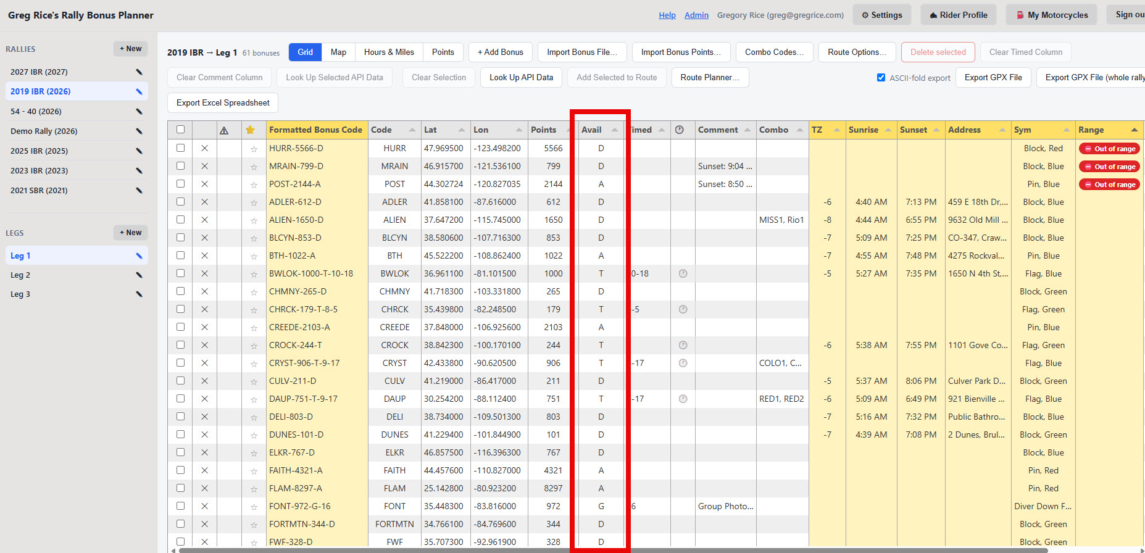
🕐
RALLIES & LEGS
How timed bonuses work
The Avail column shapes and scores a bonus: A=Anytime, D=Daylight, T=Timed, S=Special, G=Group Photo, H=Checkpoint
AC/DC/TC mark combo variants (24-hour / daylight / timed)
For a Timed bonus, fill in the Timed column with a plain-text window, e.g. 930a-6p — this is what exports to GPX/XLSX
A filled clock icon next to Timed means a structured window is already set for that row
The plain Timed text column with its small 🕐 column right beside it.
Rally Bonus Planner — Rider Guide
19 / 52

Slide 21
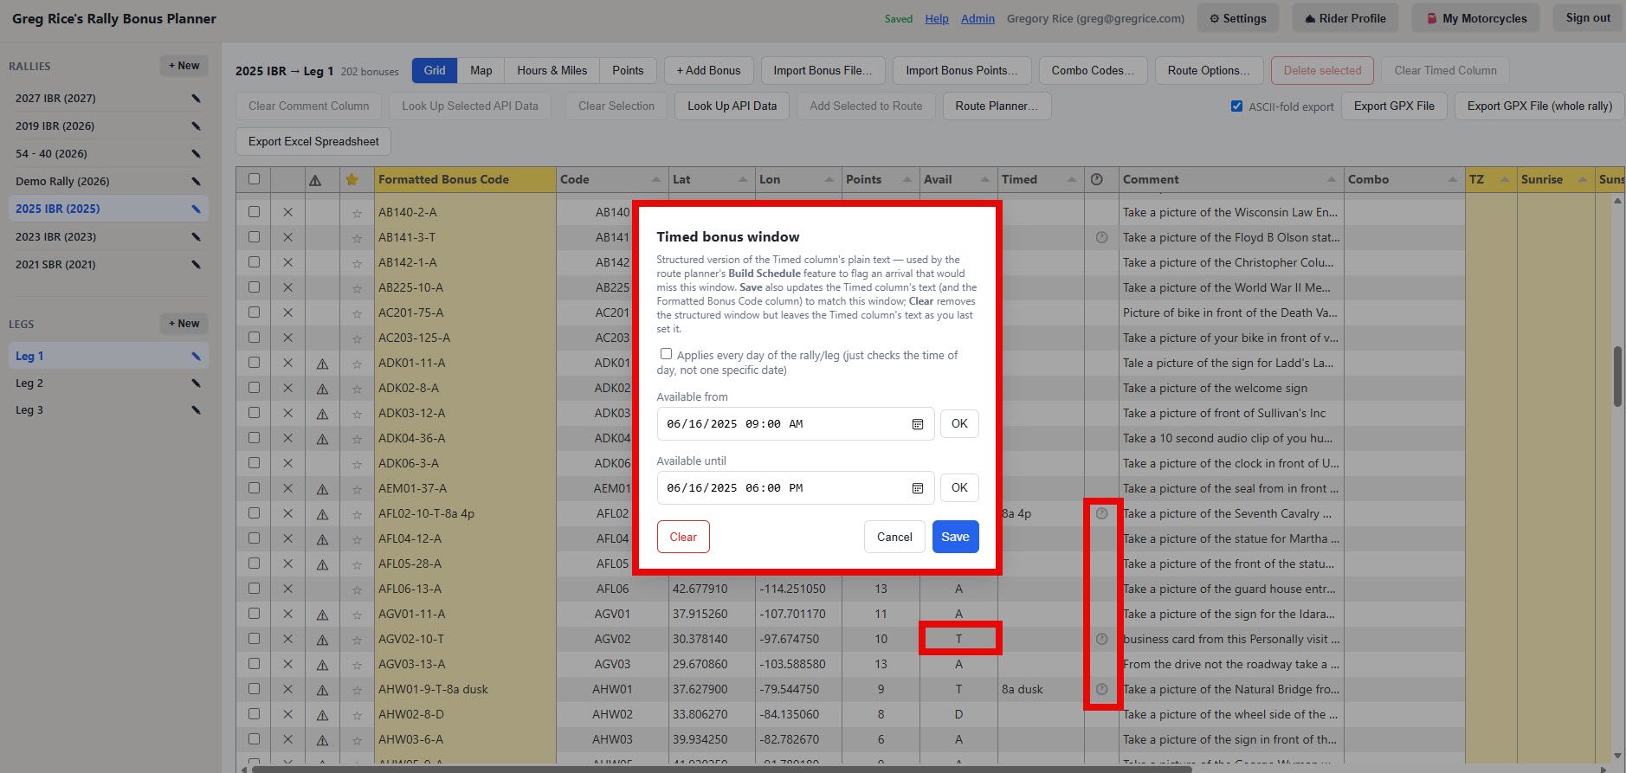
🕐
RALLIES & LEGS
Setting a structured timed window
For a Timed or Timed-Combo bonus, click the 🕐 icon to open Available from / Available until pickers
This structured window is separate from the plain Timed text — it doesn't change what's exported
It's what Build Route Schedule checks your estimated arrival against, flagging anything that would miss it
Leave it unset and the schedule builder simply can't verify that bonus, rather than assuming you'll make it
The Timed bonus window dialog — set Available from / until, then Save.
Rally Bonus Planner — Rider Guide
20 / 52

Slide 22
3
Weather
Check 10-day forecasts for any bonus, and overlay live precipitation radar on the map.
Rally Bonus Planner — Rider Guide
21 / 52

Slide 23
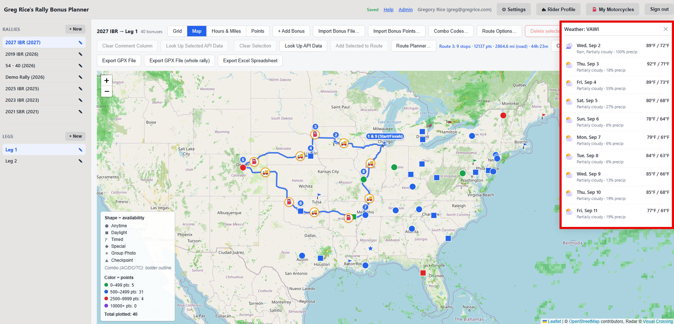
☀️
WEATHER
Weather forecasts
From a marker's popup on the map, click 10-day weather
Opens a forecast panel for that bonus's exact location
Shows daily highs/lows, conditions, and precipitation chance
Close it with the × in the top-right corner
The weather panel, opened from a map popup.
Rally Bonus Planner — Rider Guide
22 / 52

Slide 24
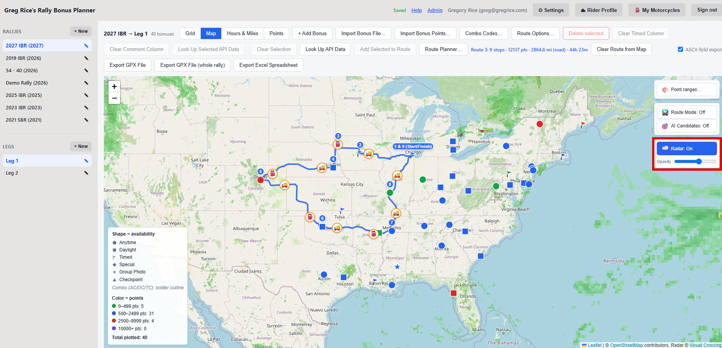
🌧️
WEATHER
Weather radar overlay: on and off
Click Radar: Off (top-right of the map) to switch on a live precipitation radar overlay
Click it again — now labeled Radar: On — to turn it off
The slider next to the button fades the overlay's opacity, so markers and the route line still show through
Useful for spotting weather along a whole route at a glance, instead of checking each bonus one at a time
Radar turned on, with opacity lowered so markers and the route line still show.
Rally Bonus Planner — Rider Guide
23 / 52

Slide 25
4
The Map & Building a Route
Plot bonuses by point value and availability, then click your way to a route.
Rally Bonus Planner — Rider Guide
24 / 52

Slide 26
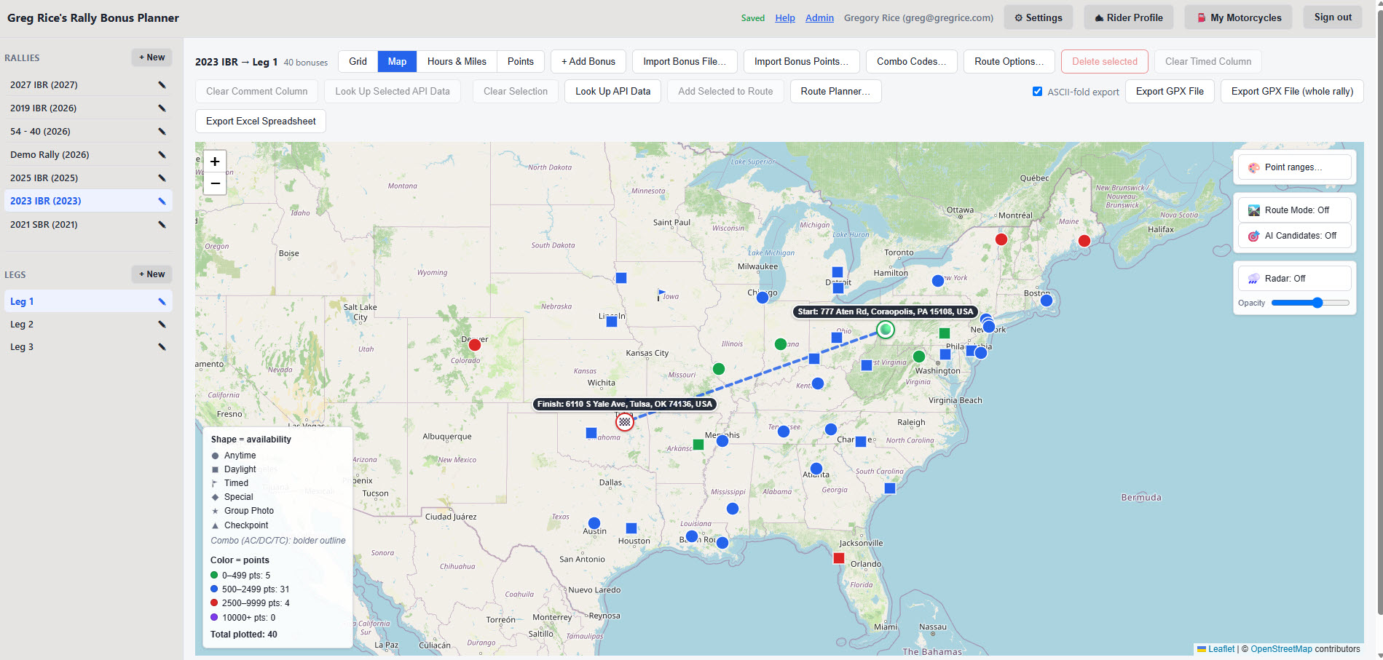
🗺️
THE MAP
Map view
Click Map next to Grid in the toolbar to switch views
Each bonus is a marker whose shape encodes availability (circle, square, flag, diamond, star, triangle) and whose color encodes point value
Combo bonuses get a bolder outline; the legend (lower-left) explains the encoding and totals plotted points
A dimmed marker means Out of range — still fully clickable, never hidden
Map view for a leg with many bonuses plotted.
Rally Bonus Planner — Rider Guide
25 / 52

Slide 27
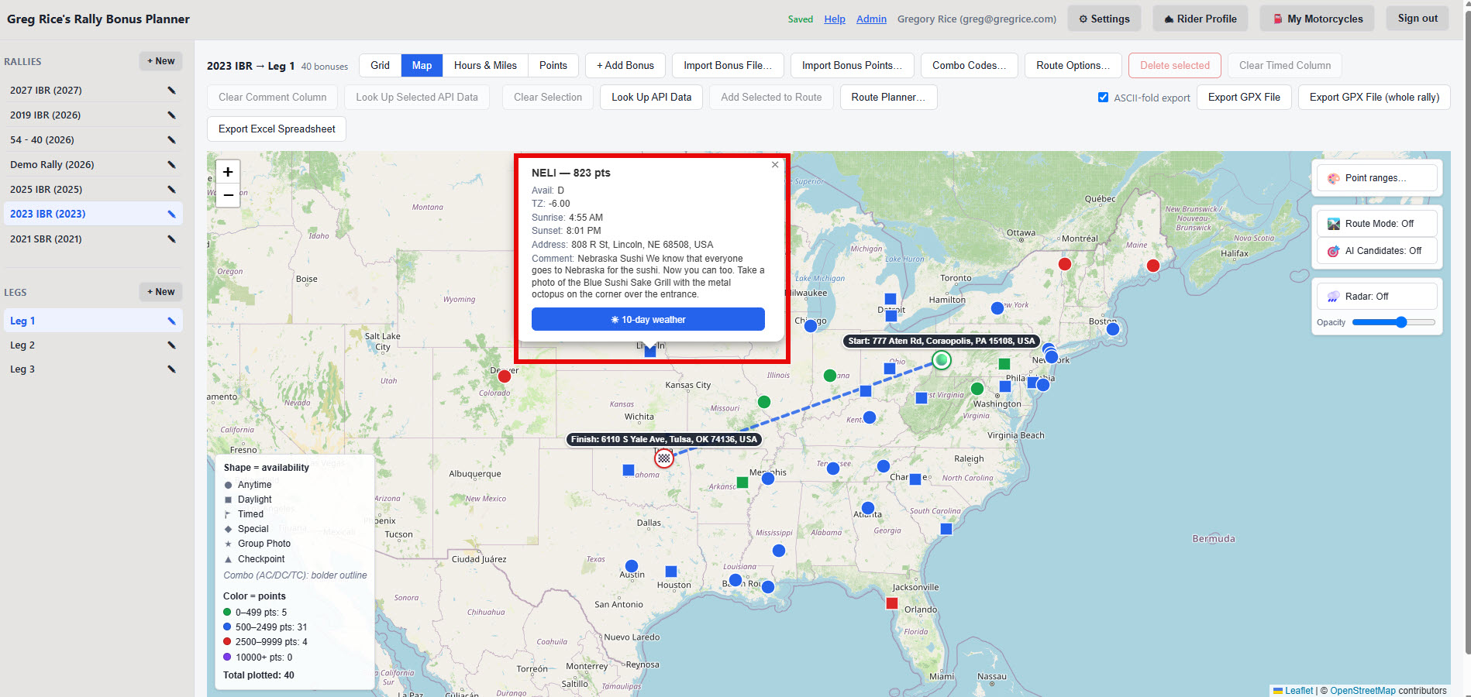
📌
THE MAP
Marker popups
Click any marker to see its details: availability, timezone, address
One click through to its 10-day weather forecast
Hovering a flagged marker shows "Out of range" right in its tooltip, alongside code and points
Point ranges… (top-right) lets you customize the point thresholds and colors used on the map
A marker popup — availability, timezone, address, and a weather shortcut.
Rally Bonus Planner — Rider Guide
26 / 52

Slide 28
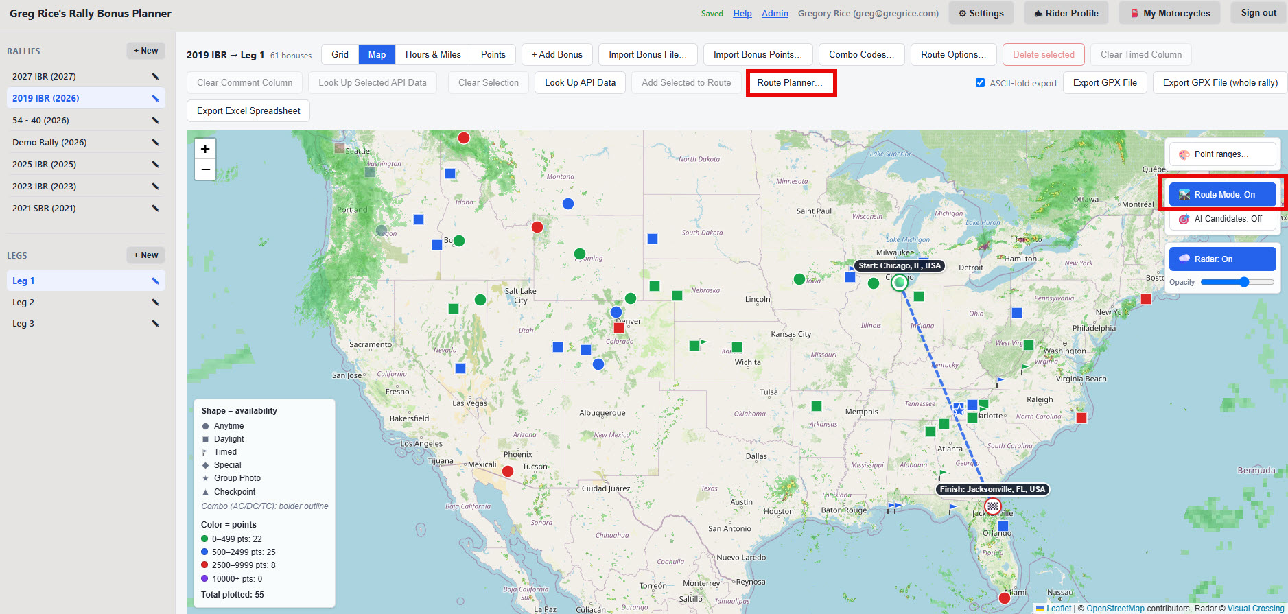
🖱️
THE MAP
Point-and-click: Route Mode
In Map view, click Route Mode: Off (top-right) to turn it on
Click bonus markers in the order you'd ride them — a numbered badge appears on each one you add
Click a marker again to remove that stop; turn Route Mode back off to return to normal popups
To close a loop, click the first stop again once the rest are added — its marker then shows both stop numbers
Add Selected to Route, Route Planner…, and Route Mode — the map's routing toolbar.
Rally Bonus Planner — Rider Guide
27 / 52

Slide 29
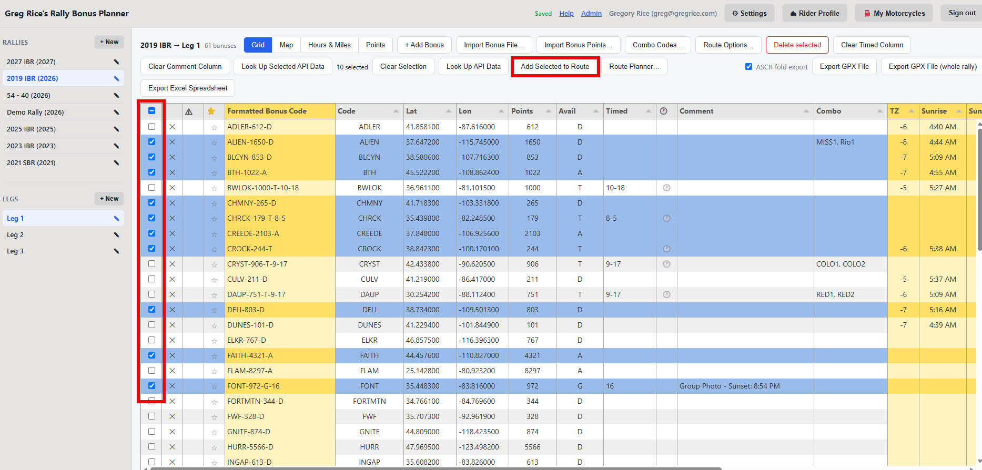
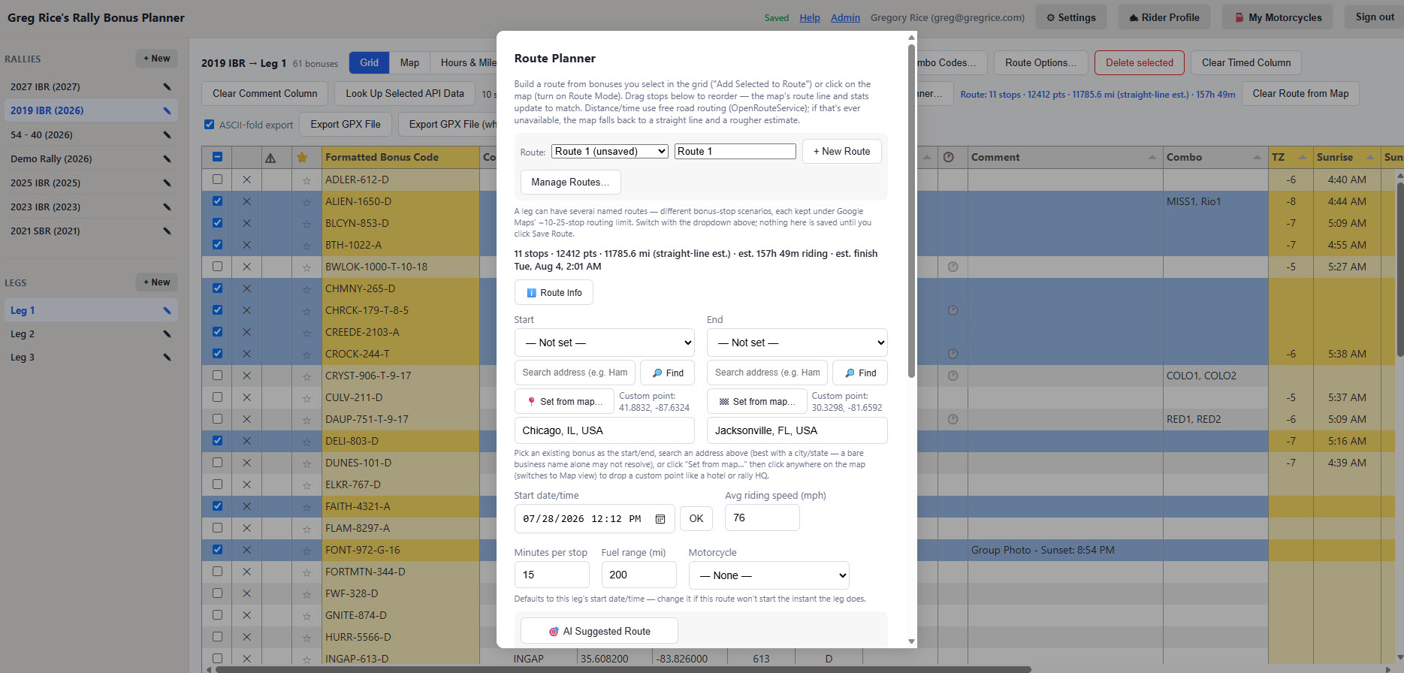
☑️
THE MAP
Or add stops from the grid
In Grid view, check the bonuses you want — the same checkboxes used for delete/lookup
Click Add Selected to Route — stops land in the route order the grid's rows are in, not the order you checked them
Mix both methods freely on the same route: some stops from the grid, some clicked on the map
Open Route Planner… any time to see, reorder, or trim the full stop list
Check bonuses in Grid view, then click Add Selected to Route.
The selected bonuses land in the route as new stops.
Rally Bonus Planner — Rider Guide
28 / 52

Slide 30
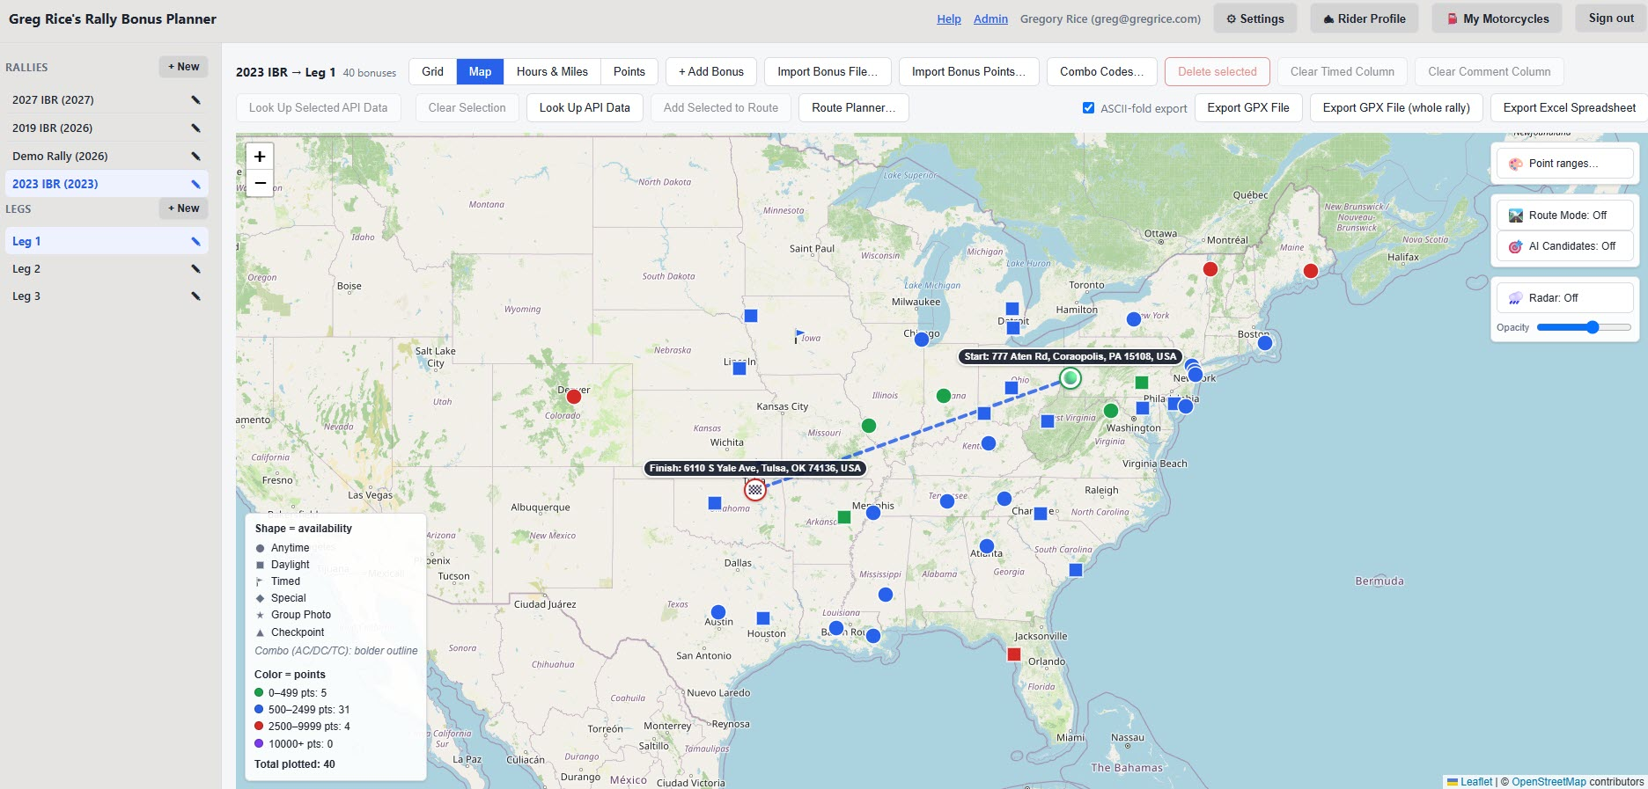
🟢
THE MAP
Start, End, and your motorcycle
Start/End accept an existing bonus from a dropdown, or a custom point — a hotel, rally HQ, anywhere else
Type an address and click 🔎 Find, or Set from map… to drop a pin by hand
If a leg has a saved Start/End location, the route's pickers default to it automatically
The Motorcycle dropdown attaches a saved bike to the route and fills in Fuel range from its tank/MPG numbers
🟢 Start at the rally's home base, 🏁 Finish at that night's hotel — filled in automatically.
Rally Bonus Planner — Rider Guide
29 / 52

Slide 31
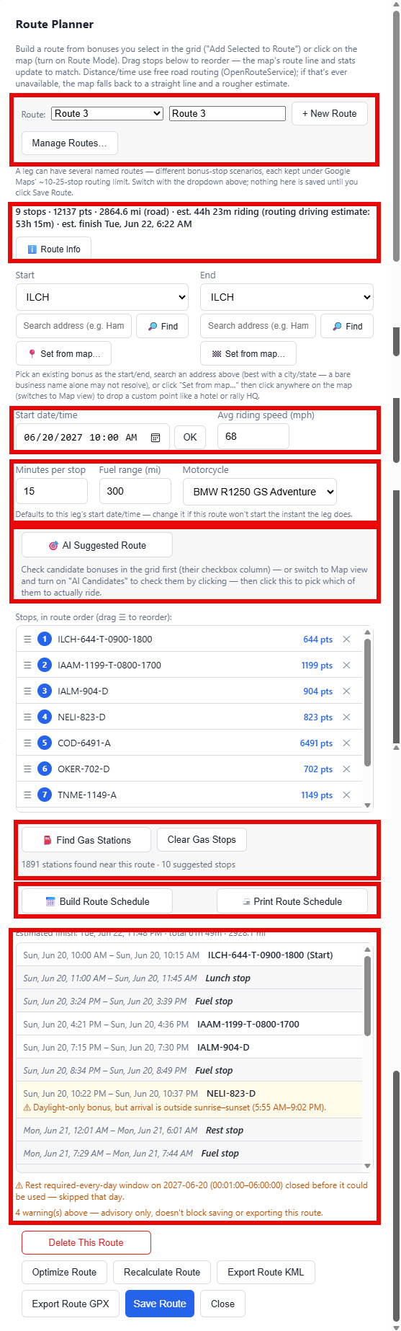
🧰
THE MAP
The Route Planner popup
Click Route Planner… any time to open the full panel: Route picker, live stats, Start/End, pace, and the stop list
Drag stops (☰) to reorder, click ✕ to remove one
Set Avg moving speed and Minutes per stop — these feed the estimated ride time
🎯 AI Suggested Route, Find Gas Stations, Build Route Schedule, Optimize Route, and every export live right here
The full Route Planner panel, section by section.
Rally Bonus Planner — Rider Guide
30 / 52

Slide 32
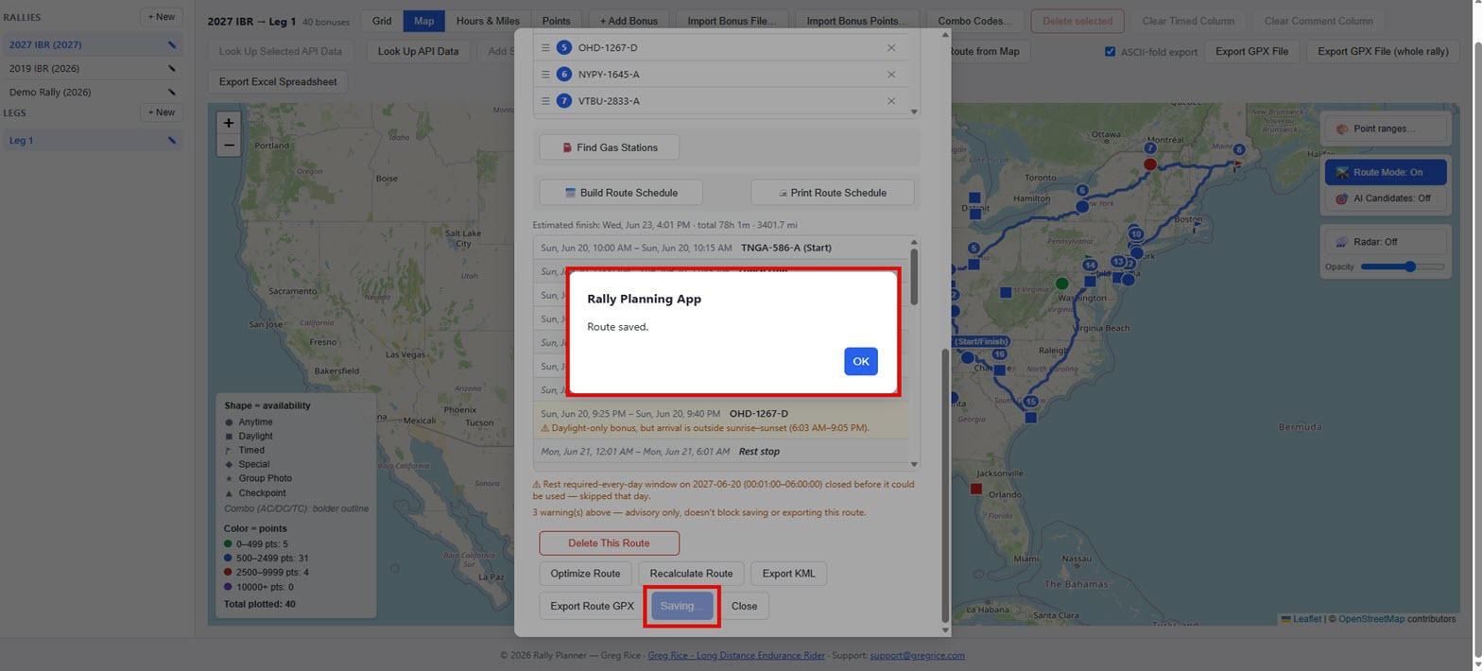
🔄
THE MAP
Recalculating the road route
Recalculate Route swaps a straight-line estimate for a real road distance from road-routing data
Save Route keeps it for next time you open this leg; Delete This Route removes it
Export Route GPX / Export KML download the stops as a route for Basecamp, Garmin, or a GPS
Your GPS recalculates the actual road path itself once you load and activate the route
Recalculate Route swaps the straight-line estimate for a real road distance.
Rally Bonus Planner — Rider Guide
31 / 52

Slide 33
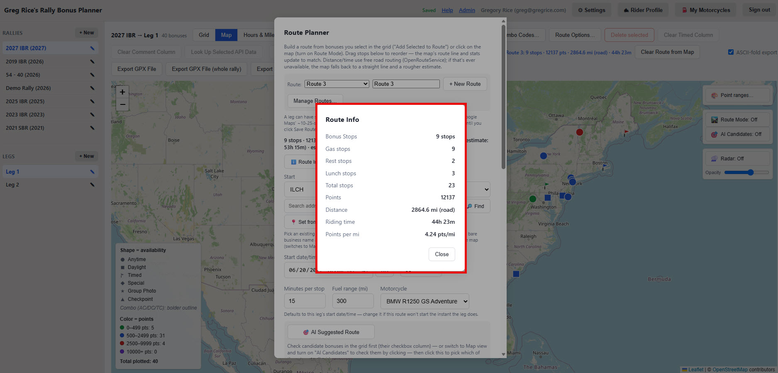
ℹ️
THE MAP
Route Info: points and efficiency
The route's stats line always shows stop count, points, distance, and estimated ride time as you build it
The ℹ️ Route Info button pops up a clean, screenshot-friendly summary of all of it
Includes points per mile — the efficiency number riders like to compare after a rally
It's on the printed route schedule too, so it travels with whatever you save or share
Stops, Points, Distance, Riding time, and Points per mile, all in one popup.
Rally Bonus Planner — Rider Guide
32 / 52

Slide 34
5
AI Suggested Route & the Optimizer
Let the app pick the highest-value bonuses for you, or just clean up the order of stops you already picked.
Rally Bonus Planner — Rider Guide
33 / 52

Slide 35
🎯
AI & OPTIMIZATION
🎯 AI Suggested Route
Optimize Route only reorders stops you've already picked — AI Suggested Route picks which bonuses to ride in the first place
Aims to score the most total points while still getting you back to your End point by the leg's end date/time
Build a candidate pool: check bonuses in the grid, or turn on 🎯 AI Candidates in Map view and click markers
Requires the leg's Start and End date/time — it refuses to run without a hard deadline to plan against
🎯 AI Suggested Route lives right in the Route Planner panel.
Rally Bonus Planner — Rider Guide
34 / 52

Slide 36
🎯
AI & OPTIMIZATION
What feeds the AI search
Your Rider Profile (optional) — pre-fills average speed and preferred stop length; defaults to 55 mph / 15 min if skipped
A motorcycle profile (optional) — pre-fills Fuel range from that bike's tank size and MPG; defaults to 200 miles if skipped
⭐ Mandatory bonuses are seeded in first as hard requirements — a 5-point mandatory can't be edged out by an optional 500-point bonus
Rest/lunch rules from the rally or leg (optional) are respected in the schedule it builds
Set your defaults once — every route you plan afterward starts from your own numbers.
Rally Bonus Planner — Rider Guide
35 / 52

Slide 37
✅
AI & OPTIMIZATION
Reading the result
Every run reports "Suggested route: N of M candidate bonus(es) included…" plus a Not included list
Each excluded bonus gets a plain-English reason — ran out of time, missed a Timed/Daylight window, or hit the stop cap
If any Daylight-only candidate is missing its sunrise/sunset lookup, you're warned before the search even runs
A mandatory bonus that genuinely can't fit tells you clearly, instead of a route that's quietly missing it
The same stats line and Route Info popup apply to an AI-suggested route too.
Rally Bonus Planner — Rider Guide
36 / 52

Slide 38
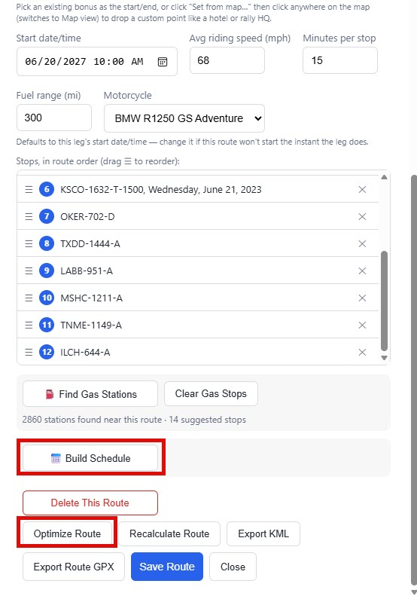
🔀
AI & OPTIMIZATION
Route optimizer
Optimize Route reorders your existing stops for the shortest overall ride
Keeps any Start/End you've set fixed at the ends; never adds or removes stops — your bonus selection stays your own pick
Builds a rough starting order (nearest-neighbor), then repeatedly improves it (2-opt) until no swap shortens it further
Automatically recalculates the real road route afterward, so the map never shows a stale straight line
Optimize Route sits right in the stop list, next to Build Schedule.
Rally Bonus Planner — Rider Guide
37 / 52

Slide 39
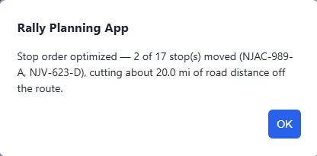
📊
AI & OPTIMIZATION
What changed, and how much shorter
After optimizing, a message reports exactly what changed — how many stops moved, and roughly how much distance was saved
For smaller routes, it names which stops moved by their bonus code
If your stops were already in the shortest order, it tells you that too, rather than leaving you to wonder
If road distances are briefly unavailable, it falls back to straight-line distances and says so
The confirmation shown after optimizing.
Rally Bonus Planner — Rider Guide
38 / 52

Slide 40
6
Gas Stops & the Ride Schedule
Find fuel along the way, then build (and print) a full arrival/departure timeline.
Rally Bonus Planner — Rider Guide
39 / 52

Slide 41
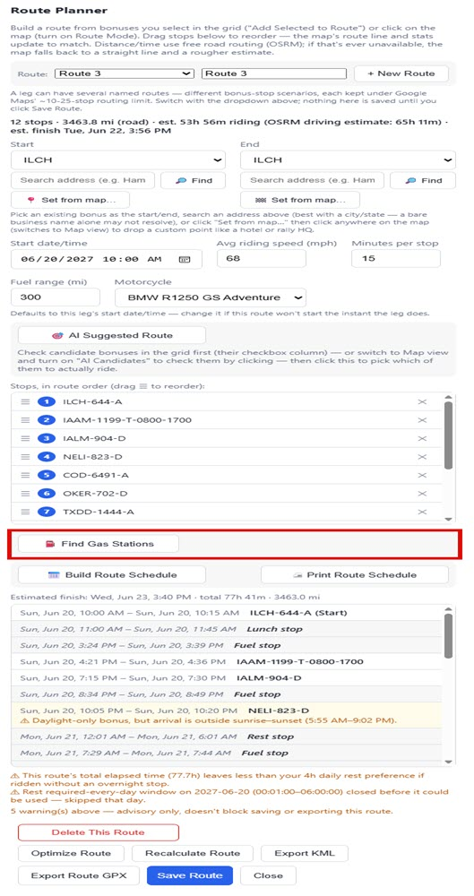
⛽
GAS & SCHEDULE
Gas station search
Once a route has at least two stops, ⛽ Find Gas Stations searches near the route line for places to fuel up
Set Fuel range (mi) to your bike's real tank range first — stops are suggested roughly every 90% of that range
A 24h-reliable station (truck stop or known 24-hour brand) is preferred when one's nearby
If the whole route fits inside a single tank, no stops are suggested at all
⛽ Find Gas Stations, right in the Route Planner panel.
Rally Bonus Planner — Rider Guide
40 / 52

Slide 42
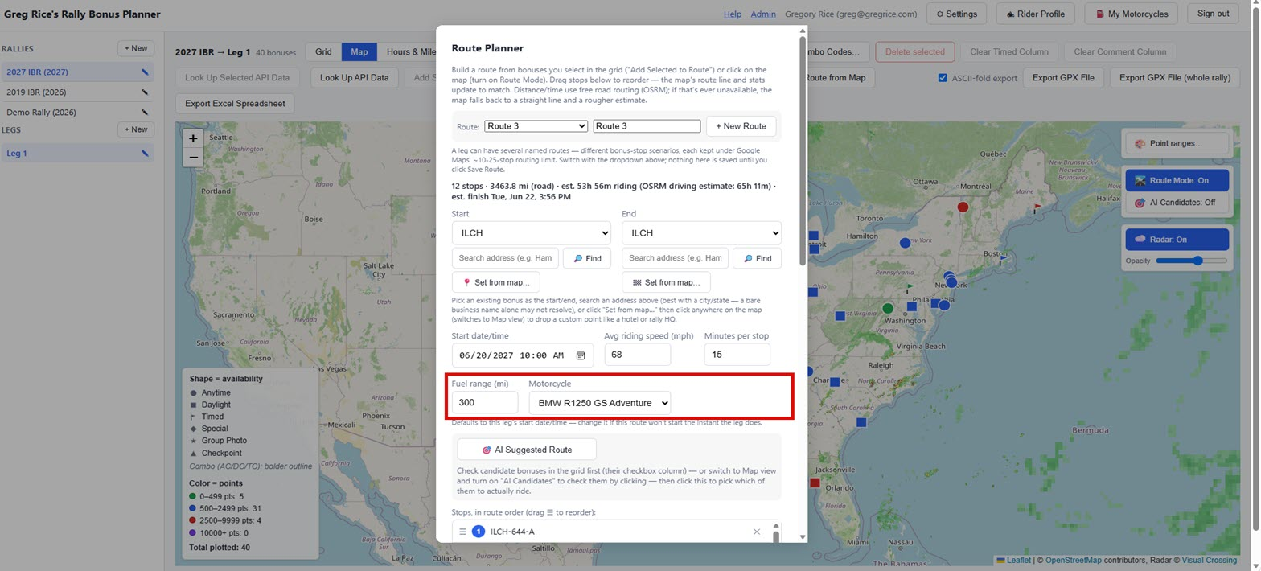
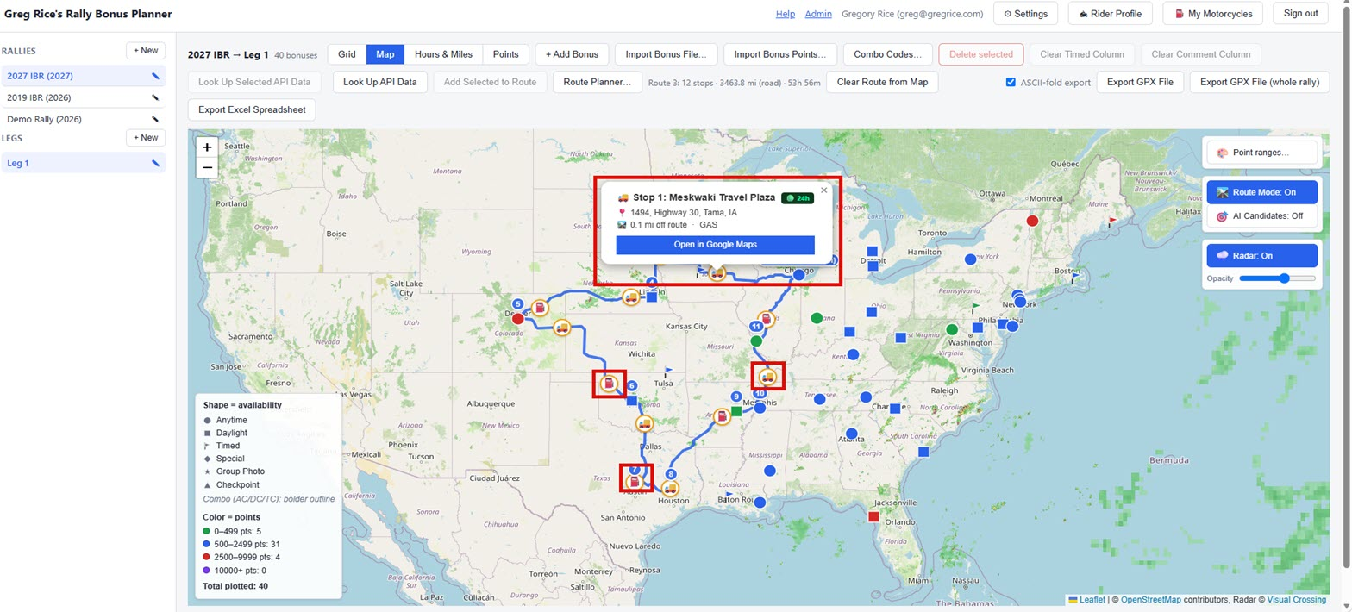
⛽
GAS & SCHEDULE
Choosing a fuel stop
Click any fuel-stop marker for its details: station name, an "hours vary" or "24h" badge, address, and how far off-route it sits
Open in Google Maps hands off turn-by-turn directions straight to your phone
This is a planning aid only — nothing here is saved with the route or included in exports
It resets automatically whenever the route's stops change, so it's always answering for the route as it stands now
Station details — hours, address, distance off-route, fuel type.
A full route with its suggested fuel stops plotted.
Rally Bonus Planner — Rider Guide
41 / 52

Slide 43
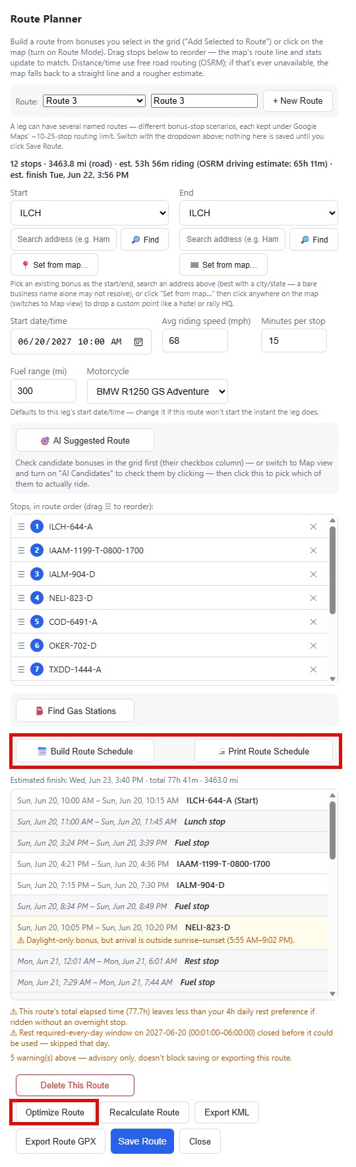
📅
GAS & SCHEDULE
Build & print a route schedule
📅 Build Route Schedule builds a full timeline: arrival and departure at every stop
Inserts rest, lunch, and fuel stops wherever they'd actually trigger — even mid-leg on a long stretch
Flags — but never blocks — any Daylight-only or Timed bonus your arrival time would miss
Print Route Schedule turns it into a clean, printable page with the same points-per-mile summary as Route Info
Build Schedule and Optimize Route, right below the stop list.
Rally Bonus Planner — Rider Guide
42 / 52

Slide 44
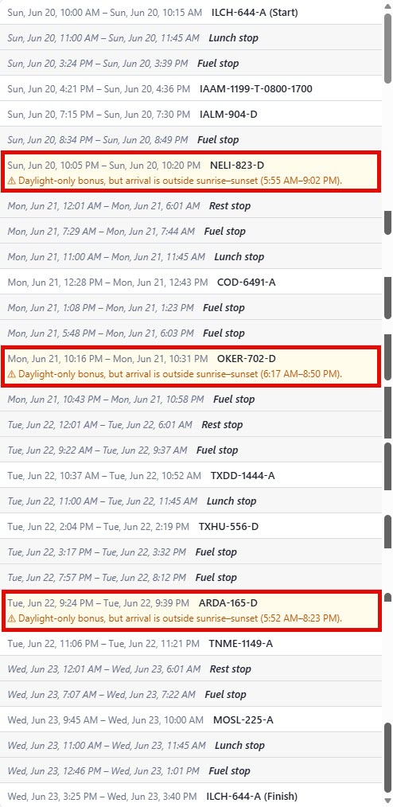
⏱️
GAS & SCHEDULE
Reading the schedule's warnings
Every warning is advisory only — nothing here blocks saving or exporting the route
A Timed bonus with no structured window set shows "could not verify" instead of a false pass or fail
A Daylight-only bonus arriving outside sunrise–sunset is flagged with the exact window it missed
Re-running the schedule after any change — a new stop, a different pace — is one click away
Timed and Daylight-only warnings appear right at the stop they apply to.
Rally Bonus Planner — Rider Guide
43 / 52

Slide 45
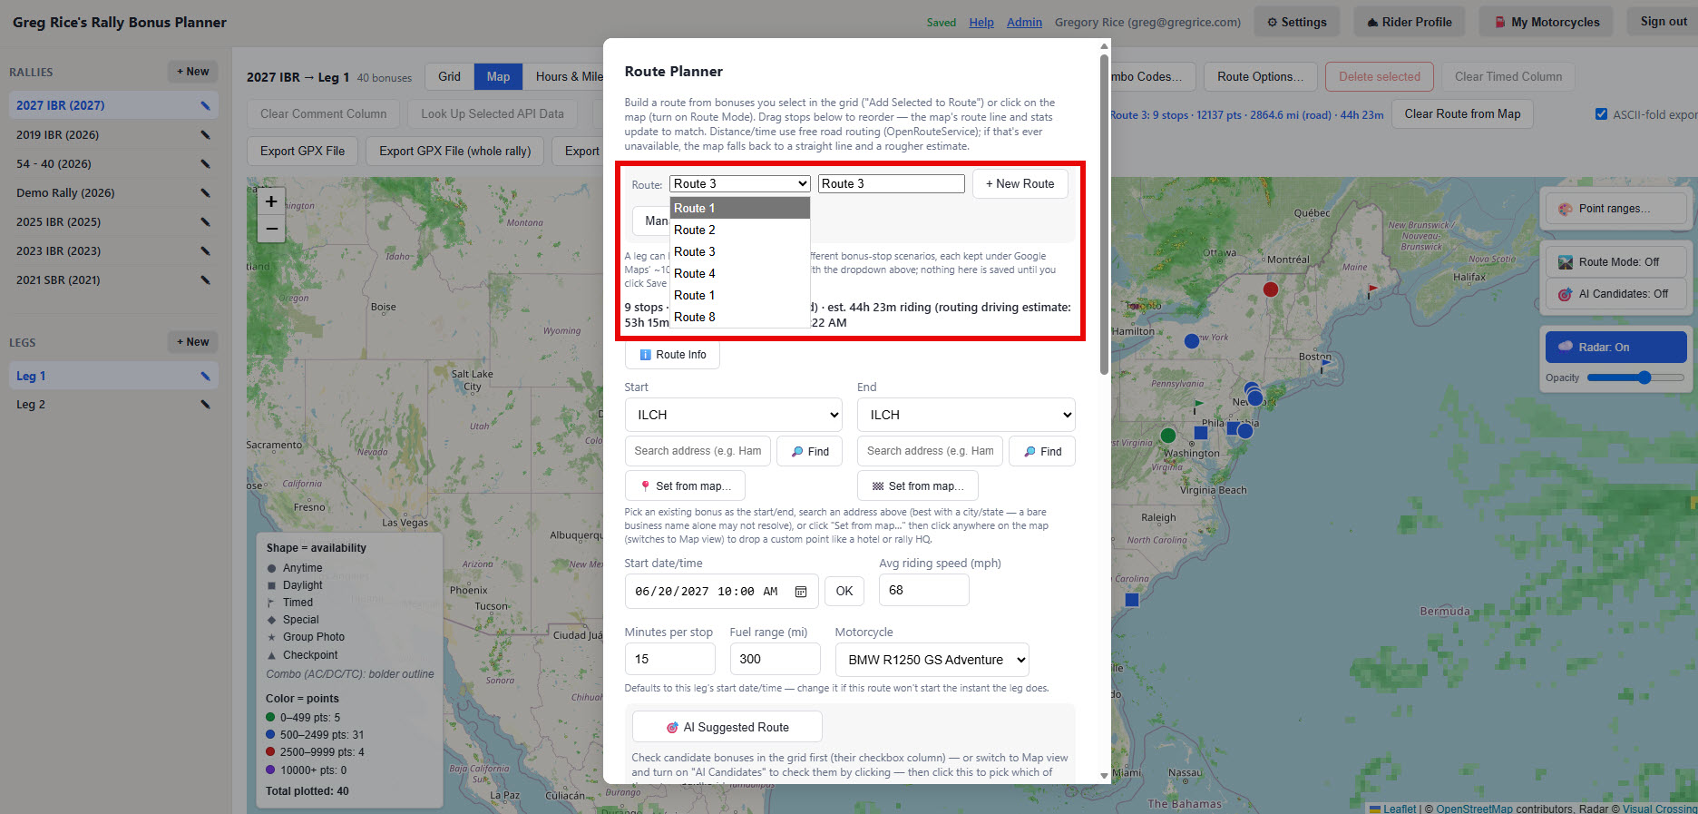
🗂️
GAS & SCHEDULE
Multiple routes per leg
A leg isn't limited to one route — the Route: dropdown builds and saves several named scenarios for the same leg
Useful because Google Maps-based tools can reject a route with more than ~10–25 stops in one go
Split a big leg into a few smaller routes, each comfortably under that limit
+ New Route starts a blank scenario; nothing is written until you add stops and save it
The Route: dropdown lists every saved route for this leg.
Rally Bonus Planner — Rider Guide
44 / 52

Slide 46
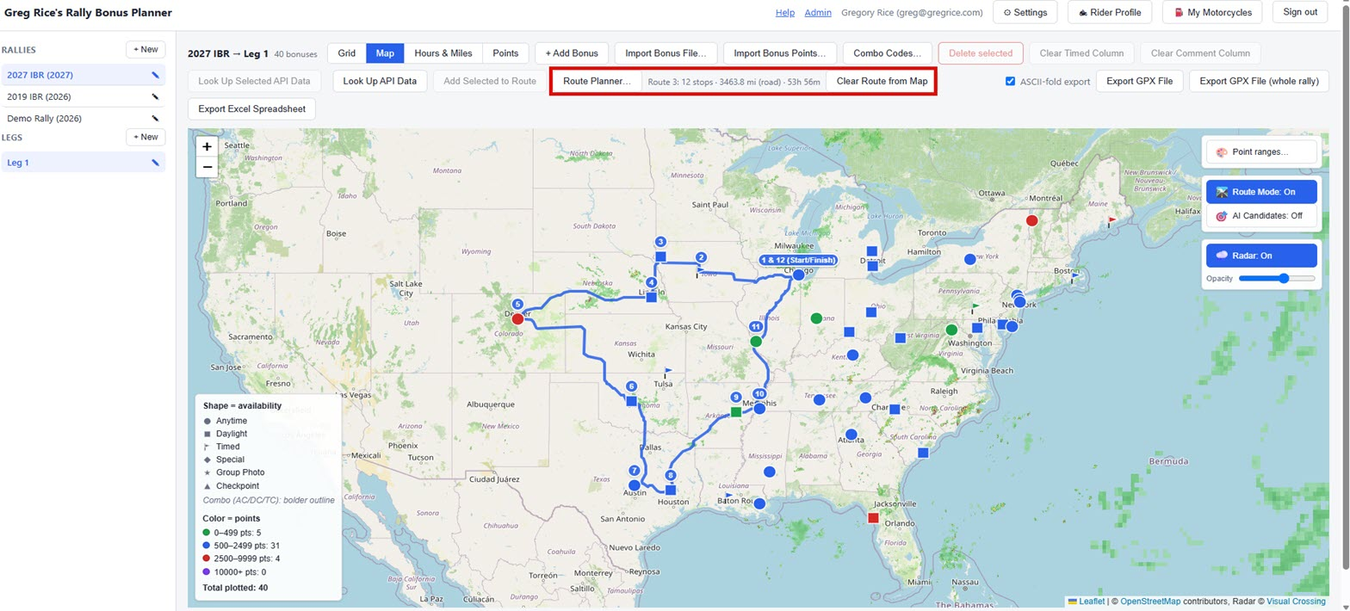
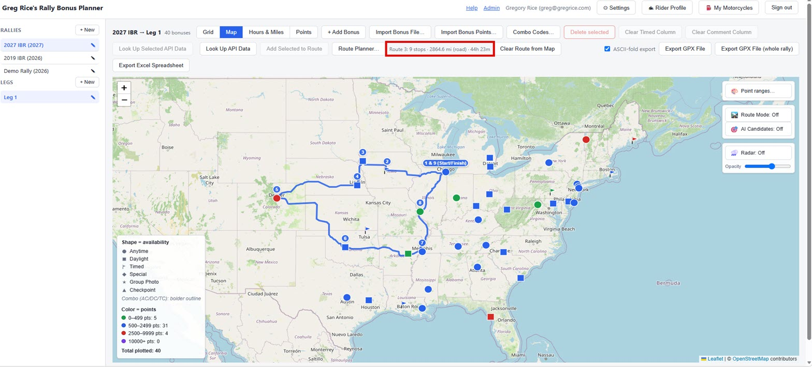
🗂️
GAS & SCHEDULE
Switching between saved routes
Switching the dropdown swaps the map's route line and stats to match whichever route is selected
Exporting GPX/KML names the file after the specific route, so two scenarios never overwrite each other
Clear Route from Map hides the current route and its gas stops without deleting anything
Pick it again from the dropdown any time to bring it right back
One saved route for this leg — 12 stops.
A different, shorter scenario for the same leg — 9 stops.
Rally Bonus Planner — Rider Guide
45 / 52

Slide 47
7
Hours & Miles, and Points
Two rally-wide worksheets for planning your pace and your score before you ever leave the driveway.
Rally Bonus Planner — Rider Guide
46 / 52

Slide 48
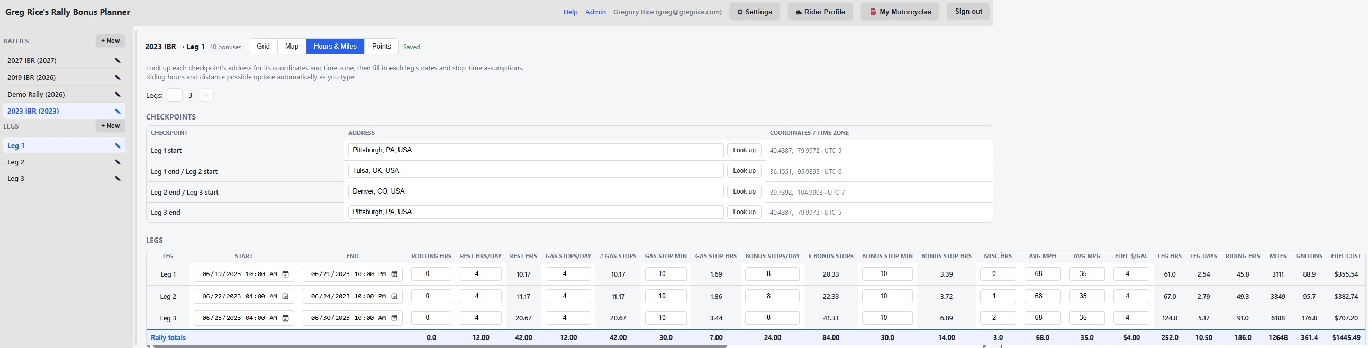
⏱️
PLANNING WORKSHEETS
Hours & Miles page
Click Hours & Miles in the toolbar for this rally's planning worksheet — covers up to 3 legs
Checkpoints table resolves each leg's start/end address to coordinates and a time zone
Legs table: your inputs on the left (rest, gas stops, bonus stops, misc hours) and computed riding hours/miles on the right
A bold Rally totals row sums everything across every leg in use — saved automatically as you type
Checkpoints, a Legs table, and a bold Rally totals row along the bottom.
Rally Bonus Planner — Rider Guide
47 / 52

Slide 49
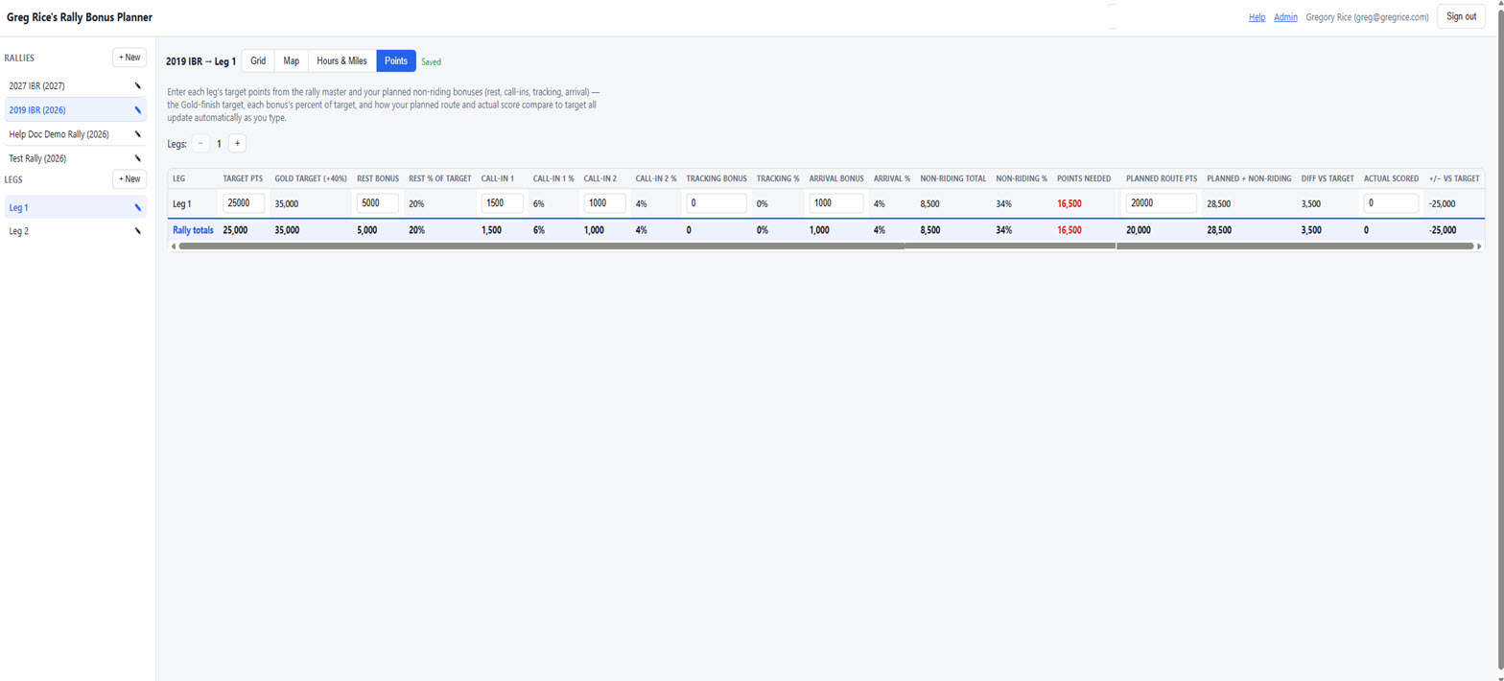
🏆
PLANNING WORKSHEETS
Points page
Click Points in the toolbar for this rally's bonus point plan — how many points each leg needs
Enter the Target points the rally master published, plus your planned rest/call-in/tracking/arrival bonuses
The red Points needed column updates live: how many bonus points your route still needs to hit target
Fill in Planned route pts from your route, then Actual scored after the rally to see your final +/− vs. target
Target and non-riding inputs on the left, the red Points needed column, and a Rally totals row.
Rally Bonus Planner — Rider Guide
48 / 52

Slide 50
8
Exporting Your Work
Take everything you've built out of the browser and onto your GPS.
Rally Bonus Planner — Rider Guide
49 / 52

Slide 51
📤
EXPORTING
Exporting GPX & XLSX
Export GPX — every bonus waypoint for the current leg, ready to load onto a GPS or into Basecamp
Export GPX (whole rally) — every leg's bonuses in one file
Export XLSX — a spreadsheet copy of the current leg's grid
ASCII-fold export (on by default) strips accented characters for older GPS units that don't handle them well
The export buttons live on the right side of the grid's toolbar.
Rally Bonus Planner — Rider Guide
50 / 52

Slide 52
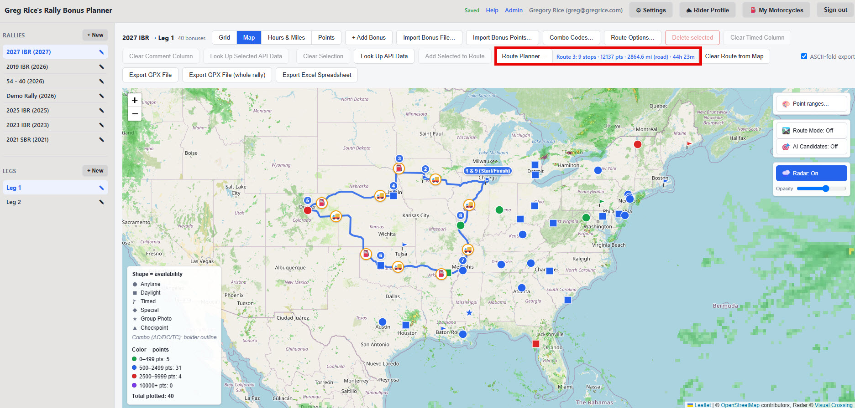
🛣️
EXPORTING
Exporting your actual route
Want a real road-following line, not just a flat waypoint list? That's the Route Planner's own export
Export Route GPX and Export KML include the calculated route line, ready for Basecamp, Garmin, or a GPS
Named after the specific route, so exporting two scenarios from the same leg gives two distinct files
Your GPS recalculates the exact road path itself once you load and activate the route
The finished route — a road-following line through every stop.
Rally Bonus Planner — Rider Guide
51 / 52

Slide 53
🎯
Ride safe, and good luck finding those bonuses.
Questions? support@gregrice.com
Rally Bonus Planner · Greg Rice · Long Distance Endurance Rider

